Slide 1
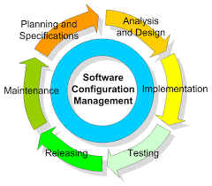
Software configuration management
Text Book
Alexis Leon, A Software configuration management handbook. Artech House. 2015.

Slide 2
Why Software Configuration Management ?
The problem:
  Multiple people have to work on software that is changing
  More than one version of the software has to be supported:
    Released systems
    Custom configured systems (different functionality)
    System(s) under development
    Software on different machines & operating systems
Need for coordination
Software Configuration Management
  manages evolving software systems
  controls the costs involved in making changes to a system.

Slide 3
What is Software Configuration Management?
Definition Software Configuration Management:
  A set of management disciplines within a software engineering process to develop a baseline
  Software Configuration Management encompasses the disciplines and techniques of initiating, evaluating and controlling change to software products during and after a software project
Standards (approved by ANSI)
  IEEE 828: Software Configuration Management Plans
  IEEE 1042: Guide to Software Configuration Management.
  SCM deals with issues related to control of software changes, proper documentation of changes, registering and storing the approved software versions, tracking registered versions and more throughout the software system’s life cycle.

Slide 4
What is Configuration Management
“SCM is the control of the evolution of complex systems,…, for the purpose to contribute to satisfying quality and delay constraints.”
– Jacky Estublier
“SCM provides the capabilities of identification, control, status accounting, audit and review, manufacture, process management, and teamwork.”
– Susan Dart

Slide 5
What is CM (cont.)
CM is a key process in Capability Maturity Model (recently updated to CMMI)
  Level 1-Initial: ad hoc/chaotic
  Level 2-Repeatable: basic project management and documentation
  Level 3-Defined: standard and complete process control and procedures
  Level 4-Managed: predictable process performance and precise measurements
  Level 5-Optimizing: continuous and recursive improvement to performance
CM operates through the software life cycle

Slide 6
What is CM not
Not just version control
Not just for source code management
Not only for development phase
Selecting and using tools are important, but design and management of CM process are more crucial for project success

Slide 7
Some Simple CM Scenarios
Developer A wants to see latest version of foo.c and its change history since last week
B needs to revert foo-design.doc to its version two days ago
B makes a release of the project and he needs to know what items to include and which version

Slide 8
Some Simple CM Scenarios (cont.)
A lives in New Dehli, India and B lives in Boston, US, they want to work on HelloWorld.java together
In the latest release, a serious bug is found and manager C wants to track what changes caused the bug, who made those changes and when
C wants to get reports about current project progress to decide if she needs to hire more programmers and delay the alpha release

Slide 9
SCM Responsibilities
Facilitates Timely Communication
Enforces Development Policies
Ensures Technical Standards
Manages Hand-offs between Environments and Teams

Slide 10
Common SCM myths
SCM is difficult, monotonous and time consuming activity
Responsibility of management
Just for developers
Just for SCM team
Just for maintenance and technical support team
Slow down the software development process
Only needed to get certification
Scm tolls will take care of everything
One SCM tool will suit everyone
Scm is expensive
Scm is just for source code.
Scm is change management and defect tracking
Software development can succeed with out SCM

Slide 11
SCM Basic Concepts
A software development project produces the following item
Program(source code, object code, exe code, libraries, function , subroutines)
Documentation( requirement definition, system analysis, system design etc.)
Data( test data and project data)
These item are collectively called a software configuration.

Slide 12
SCM Main Acitivity
configuration identification
Configuration control
configuration status Accounting
configuration Audit

Slide 13
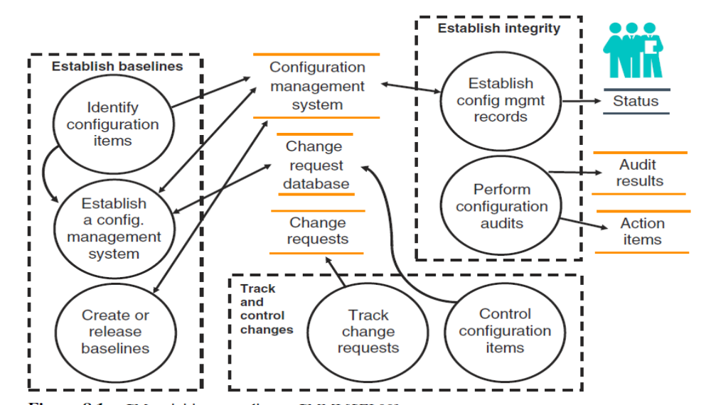
SCM Acitivity

Slide 14
SCM Terminology
Configuration Item (CI)
Version, Variant, and Revision
Configuration
Baseline
Workspace
Branches
Build, release
deltas

Slide 15
Terminology: Configuration Item
Configuration Item: An aggregation of hardware, software, or both, designated for configuration management and treated as a single entity in the configuration management process.
Software configuration items are not only source files but all types of documents
In some projects, not only software but also hardware configuration items (CPUs, bus speed frequencies) need to be put under control!

Slide 16
Define Configuration Items
Not every entity needs to be under configuration management control all the time
Two Issues:
  What: Selection of Configuration Items
    What should be under configuration control?
  When: When do you start to place entities under configuration control?
Choices for the Project Manager:
  Starting with Configuration Items too early introduces bureaucracy
  Starting with Configuration Items too late introduces chaos.

Slide 17
Define Configuration Items (continued)
Selecting the right configuration items is a skill that takes practice
  Very similar to object modeling
  Use techniques similar to object modeling for finding configuration items!
    Find the configuration items
    Find relationships between configuration items.

Slide 18
Configuration Item Candidates
Configuration Item
Candidates
Models
Subsystems
Documents
Object Model
Dynamic Model
RAD
ODD
. . . .
Database
User Interface
. . . .
“The project”
. . . .
Code
Data
Unit Test
. . . .

Slide 19
Which of these Entities should be Configuration Items?
Problem Statement
Software Project Management Plan (SPMP)
Requirements Analysis Document (RAD)
System Design Document (SDD)
Project Agreement
Object Design Document (ODD)
Dynamic Model
Object model
Functional Model
Unit tests
Integration test strategy
Source code
API Specification
Input data and data bases
Test plan
Test data
Support software (part of the product)
Support software (not part of the product)
User manual
Administrator manual

Slide 20
Possible Selection of Configuration Items
Problem Statement
Software Project Management Plan (SPMP)
Requirements Analysis Document (RAD)
System Design Document (SDD)
Project Agreement
Object Design Document (ODD)
Dynamic Model
Object model
Functional Model
Unit tests
Integration test strategy
Source code
API Specification
Input data and data bases
Test plan
Test data
Support software (part of the product)
Support software (not part of the product)
User manual
Administrator manual

Slide 21
Terminology: Baseline
Baseline: “A specification or product that has been formally reviewed and agreed to by responsible management, that thereafter serves as the basis for further development, and can be changed only through formal change control procedures.”
Examples:
  Baseline A: The API has been completely been defined; the bodies of the methods are empty
  Baseline B: All data access methods are implemented and tested
  Baseline C: The GUI is implemented.

Slide 22
Naming Schemes for Baselines
Many naming scheme for baselines exist (1.0, 6.01a, ...)
A 3 digit scheme is quite common:
7.5.5
Major,
External Release
(Customer)
Minor,
Internal Release
(Developer)
Small Revision
(Developer)

Slide 23
Types of Baselines
As systems are developed, a series of baselines is developed, usually after a review (analysis review, design review, code review, system testing, client acceptance, ...)
  Developmental baseline
  Functional baseline
  Product baseline

Slide 24
Transitions between Baselines
Baseline A (developmental)
Baseline B (functional, first prototype)
Baseline C (product, beta test)
Release
How do we manage changes in baselines?
=> Change Management
Time

Slide 25
When should based line be established?
It depends on the nature of the project and how the SCM system designer think
You can have a base line at the start of each phase.

Slide 26
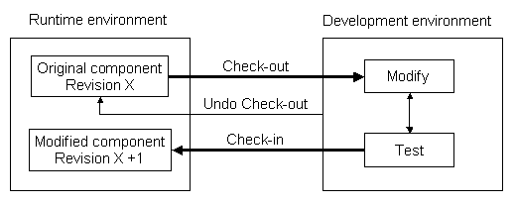
Check in and check out

Slide 27
Check-in
Process of reviewing ,approving and moving an item into the controlled environment is called check-in. Copies a file into the database.
The version you see is (usually) the latest version that was checked in.
The old version is kept and can be accessed later.
Configuration Management

Slide 28
Check out
Copies the database file to your personal folder, and raises a flag on the database copy.
Need to check out before checking in.
Configuration Management

Slide 29
Undo check out (uncheck-out)
The “undo checkout” command does just that – the file returns to the status it had before it was checked out.
This can be done even if changes have been made to the local copy – of course, these do not go into the database!
Configuration Management

Slide 30
Versions/variants/releases
Version An instance of a system which is
functionally distinct in some way from other
system instances
Variant An instance of a system which is
functionally identical but non-functionally
distinct from other instances of a system
Release An instance of a system which is
distributed to users outside of the development
team

Slide 31
Two Types of Versions:
Revision: A software object that was created by modifying an existing one.
Variant: Two software objects that have an important property in common (e.g., the functional specification, interface), but differ in others (e.g. user interface, platform, algorithms, data structures, user groups).
Blanko ‘98 22-23 Oct. 1998

Slide 32
More on Versions
Both atoms and configurations have versions.
Source objects always have versions (except perhaps bug reports).
Version group: a set of software objects related via the relations revision-of and variant-of.
Blanko ‘98 22-23 Oct. 1998

Slide 33
Version identification
Procedures for version identification should define an unambiguous way of identifying component versions
Three basic techniques for component identification
  Version numbering
  Attribute-based identification
  Change-oriented identification

Slide 34
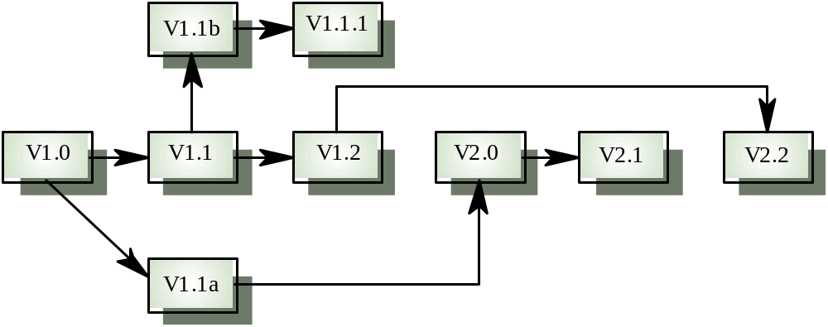
Version derivation structure

Slide 35
Version management tools
Version and release identification
  Systems assign identifiers automatically when a new version is submitted to the system
Storage management.
  System stores the differences between versions rather than all the version code
Change history recording
  Record reasons for version creation
Independent development
  Only one version at a time may be checked out for change
  Parallel working on different versions

Slide 36


Organization of Version Groups: Reservation Model
Data base (vault)
Workspace (sandbox)
Fix.1
checkout
1.1
1.2
1.3
2.1
2.2
2.3
2.3
2.3
checkin
Par.1
Par.2
Revision-of
Variant-of
Change cycle: 1. checkout (create copy in workspace, reserve template in vault)
2. modify copy in workspace
3. checkin (move workspace copy into template)
Blanko ‘98 22-23 Oct. 1998

Slide 37
Optimistic Model
Data base (vault)
Workspace 1
Fix.1
checkout
1.1
1.2
1.3
2.1
2.2
2.3
2.3
checkin
Par.1
Par.2
Revision-of
Variant-of
2.3’
Blanko ‘98 22-23 Oct. 1998
Workspace 2

Slide 38
The Branch&Merge Models
with reservation
without reservation
M.1
M.1
R.1
R.1
L.1
R.2
R.2
L.1
M.2
M.2
L.2
R.3
M.3
M.3
Blanko ‘98 22-23 Oct. 1998

Slide 39
Distributed Version Control
Boston
GUI.0
GUI.0
Tokyo
GUI.1
Kanji.1
GUI.2
Kanji.2
Kanji.3
Kanji.3
GUI.3
Kanji.4
GUI.3
GUI.4
Kanji.5
Kanji.6
Kanji.6
GUI.5
Blanko ‘98 22-23 Oct. 1998

Slide 40
Naming of version
Each version of a file has a unique Revision number. Revision numbers look like ‘1.1’, ‘1.2’, ‘1.3.2.2’ or even ‘1.3.2.2.4.5’.
By default:
  revision 1.1 is the first revision of a file.
Successive revisions incremement the rightmost number.

Slide 41
Source and derived items
An item that is created from another item or set of items is called a derived item. The items from which a derived item is created are called source items.
Eg executable program is derived item

Slide 42
System building
System building is the process of combining source components of a system in to components, which execute on a particular target configuration. At the time of system building we think
All components that make up the system been included
All require file( data, document) available in the target machine
Required tools (complier, linker)

Slide 43
System building
The process of compiling and linking software components into an executable system
Different systems are built from different
combinations of components
Invariably supported by automated tools that are driven by ‘build scripts’

Slide 44
System building problems
Do the build instructions include all required
components?
  When there are many hundreds of components making up
  a system, it is easy to miss one out
  This should normally be detected by the linker
Is the appropriate component version specified?
  A more significant problem. A system built with the wrong
  version may work initially but fail after delivery
Are all data files available?
  The build should not rely on 'standard' data files
  Standards vary from place to place

Slide 45
System building problems
Are data file references within components
correct?
  Embedding absolute names in code almost always causes
  problems as naming conventions differ from place to place
Is the system being built for the right platform
  Sometimes must build for a specific OS version or hardware
  configuration
Is the right version of the compiler and other
software tools specified?
  Different compiler versions may actually generate different code and the compiled component will exhibit different behaviour

Slide 46
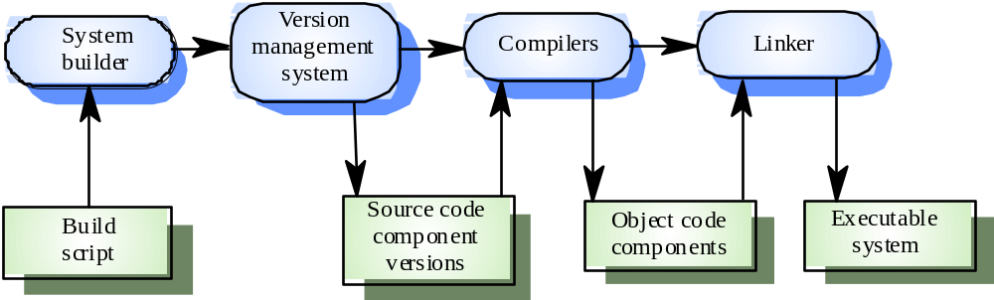
System building

Slide 47
System building tools
Building a large system is computationally expensive and may take several hours
Hundreds of files may be involved
System building tools may provide
  A dependency specification language and interpreter
  Tool selection and instantiation support
  Distributed compilation
  Derived object management

Slide 48
Releases
A release consists of more than just the executable code. It includes installation file,data file, setup programs, electronic and paper document. A release to a client or a system release contain the following information.
Installation requirement
How to install and how to test
How to upgrade from earlier version
Key or serial number of the product
List of know faults and limitations
New feature introduce in the release
Instruction for technical support.

Slide 49
Release management
Releases incorporate changes forced on the system by errors discovered by users and by hardware changes
They also incorporate new system functionality
Release planning is concerned with when to
issue a system version as a release

Slide 50
System releases
Not just a set of executable programs
May also include
  Configuration files defining how the release is configured for a particular installation
  Data files needed for system operation
  An installation program or shell script to install the system on target hardware
  Electronic and paper documentation
  Packaging and associated publicity
Systems are now normally released on CD-ROM or as downloadable installation files from the Web

Slide 51
Release problems
Customer may not want a new release of the
system
  They may be happy with their current system as the new version may provide unwanted functionality
Release management must not assume that all
previous releases have been accepted
  All files required for a release should be re-created when a new release is installed

Slide 52
Release creation
Release creation involves collecting all files and documentation required to create a system release
Configuration descriptions have to be written for different hardware and installation scripts have to be written
The specific release must be documented to record exactly what files were used to create it
  This allows it to be re-created if necessary

Slide 53
ClearCase - Overview
Rational ClearCase is a software tool for revision control of source code and other software development assets.
Basic concepts:
Items under ClearCase are generally referred to as “elements”.
For example:
design models, source files, project files, DLLs, etc.
Configuration Management

Slide 54
Advantages of ClearCase
Can handle projects that:
a) Consists from a lot of developers.
b) Go on for a very long time.
Developed and marketed by IBM,
  i.e. very smooth and natural integration with a lot of other IDE/CM/test/profiling… Tools.
Versatile – lots of possibilities and capabilities.
Configuration Management

Slide 55
Advantages – cont.
Supported by multiple OS
  Windows, Unix (Solaris, AIX, …), Linux.
  Can be accessed from client on one OS to a server on another OS.
Enables real parallel development - work on multiple versions of the same source file concurrently.
Configuration Management

Slide 56
Disadvantages
High price.
Too versatile
  one can never learn all capabilities.
Complex support
  must have very good - full time - administrator.
Configuration Management

Slide 57
Deltas
The difference between the new and the previous version is called delta.
Forward delta storage is that the system maintains a complete copy of the original file. Whenever a new version is check in the two versions are compared and a delta report is produced.
Reverse delta storage only the most recent version of the module is kept in the complete form. The previous version is deleted and the new version is stored.

Slide 58
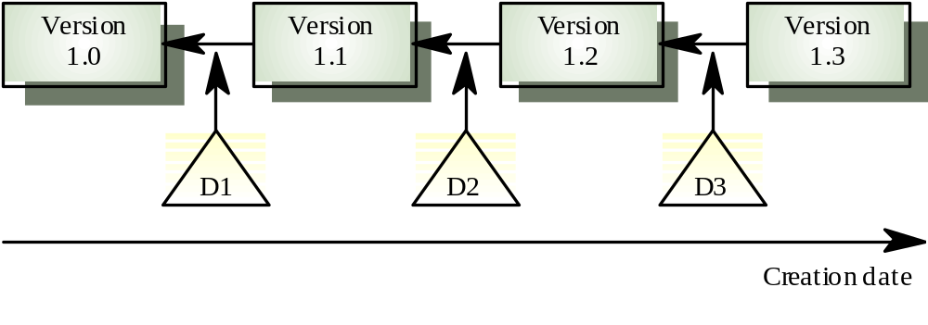
Delta-based versioning

Slide 59
Using deltas to reduce space
Data base (vault)
Workspace (sandbox)
Fix.1
checkout
2.2
2.3
1.1
1.2
1.3
2.1
2.2
2.3
2.3
checkin
Par.1
Par.2
A delta is a difference between two revisions. Can be computed in forward or backward direction on checkin. Used to regenerate one revision from another.

Slide 60
SourceSafe
Central repository of read-only files.
Everybody sees the same version.
Only one user can check in at once.
No branching.
Limited merge capabilities.
Synchronized with Visual Studio
Configuration Management

Slide 61
Advantages of SourceSafe
Synchronized with Visual Studio.
Relatively inexpensive.
Relatively simple to administrate.
Configuration Management

Slide 62
Disadvantages of SourceSafe
Does not support branching
  Requires verbal coordination.
  Poses a problem for large projects.
  Complicates development of features
Not compatible with other OS’s.
Configuration Management

Slide 63
Configuration
An arrangement of functional CIs according to their nature, version and other characteristics
Guaranteed to recreate configurations with quality and functional assurance
Sometimes, configuration needs to record
environment details, e.g. compiler version, library
version, hardware platform, etc.
Simple examples
Ant buildfile, Makefile

Slide 64
Example Configurations
Table top TT1
Instructions:Attach Legs L1 with Bolts B1 to TT1.
Legs L1
Bolts B1
Which one is a derived
configuration?

Slide 65
Configurations
Three major models:
a. Composition model (sets of software objects)
b. Change set model (bundles of changes)
c. Long Transaction Model (all changes are isolated into transactions)

Slide 66
Workspace
An isolated environment where a developer can
work (edit, change, compile, test) without interfering other developers
Examples
Local directory under version control
Private workspace on the server
Common Operations
Import: put resources into version control in repository
Update: get latest version on the default branch
Checkout: get a version into workspace
Checkin: commit changes to the repository

Slide 67
Terminology: SCM Directories
Programmer’s Directory (IEEE: Dynamic Library)
  Library for holding newly created or modified software entities
  The programmer’s workspace is controlled by the programmer only
Master Directory (IEEE: Controlled Library)
  Manages the current baseline(s) and for controlling changes made to them
  Changes must be authorized
Software Repository (IEEE: Static Library)
  Archive for the various baselines released for general use
  Copies of these baselines may be made available to requesting organizations.

Slide 68


Standard SCM Directories
Programmer’s Directory
  (IEEE Std: “Dynamic Library”)
  Completely under control of one programmer
Master Directory
  (IEEE Std: “Controlled Library”)
  Central directory of all promotions
Software Repository
  (IEEE Std: “Static Library”)
  Externally released baselines.
Promotion
Central source
code archive
Release
Foo’95
Foo’98

Slide 69
Software Configuration Management Tools
RCS: The first on the block [Tichy 1975] (rivision control system
CVS (Concurrent Version Control)
  based on RCS, allows concurrency without locking
  http://www.cvshome.org/
Subversion
  Based on CVS
  Open Source Project (http://subversion.tigris.org/)
Perforce
  Repository server, keeps track of developer’s activities
  http://www.perforce.com
ClearCase
  Multiple servers, process modeling, policy check mechanisms
  http://www.rational.com/products/clearcase/

Slide 70
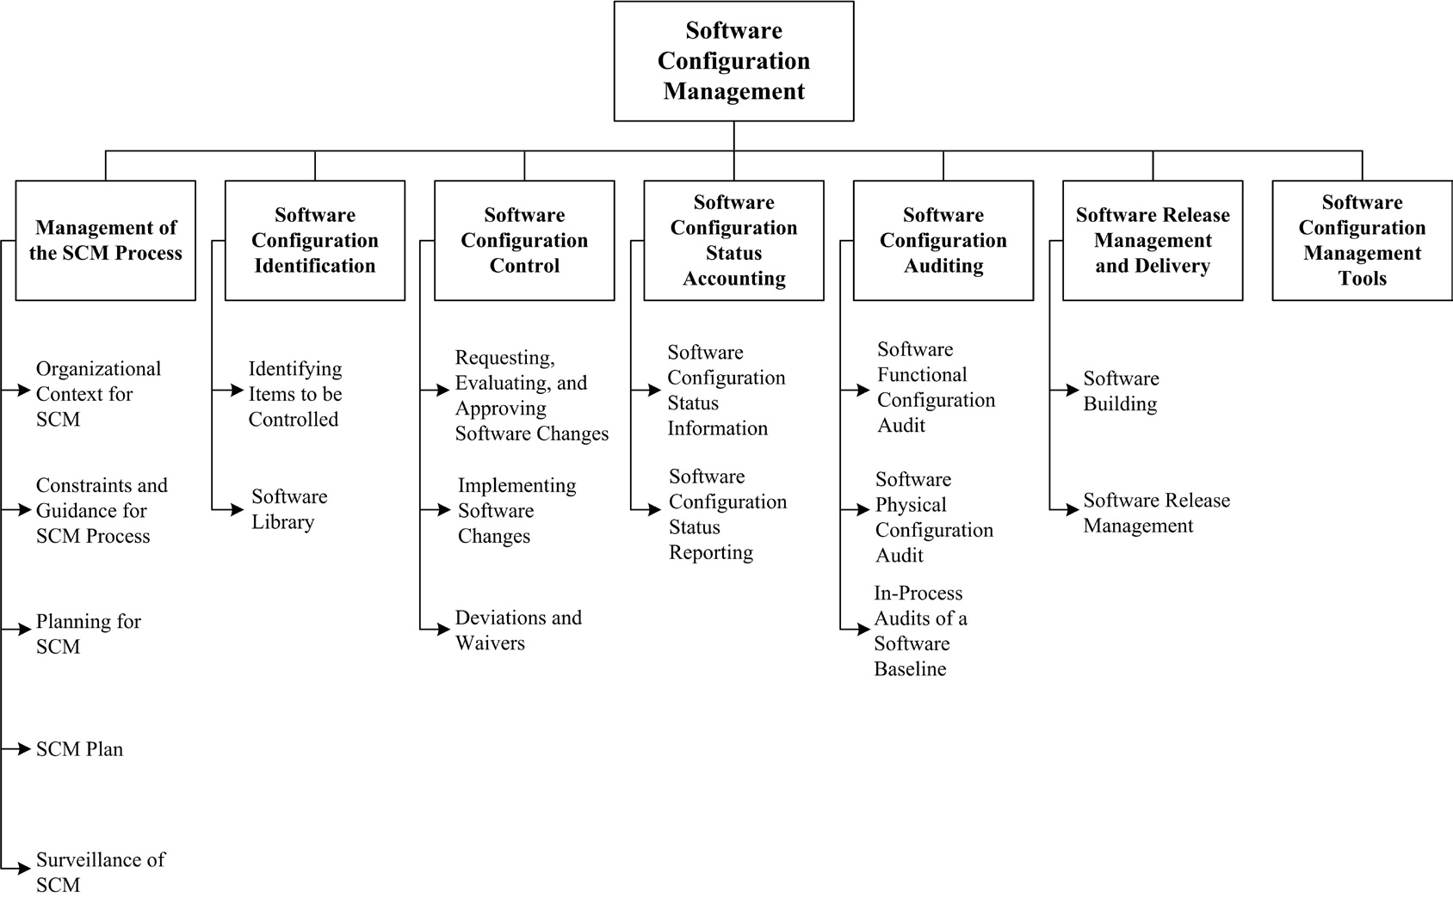
SCM overview

Slide 71

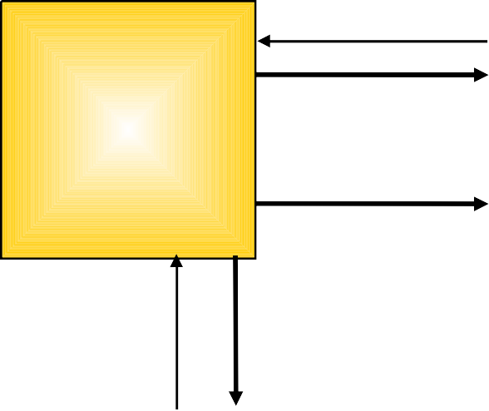
Configuration Management Process
Overview
I
GSFC
Planning Data
Project Management Processes
Configuration
CM Plan
Formulation
Project Planning
Process
Status reports; audit results
Monitoring & Control
Project Startup
Work products; change requests
Controlled work products; approved change requests
Project Closeout
Product Development Processes
Systems Engineering
Requirements Engineering
Design
Implementation
Engineering & Maintenance
Product Release
Testing
Software Configuration Management, March 2008

Slide 72
Configuration Management Tasks
I
GSFC
CM planning and startup tasks
Define levels of control and responsibilities
Identify configuration items
Prepare the CM Plan
Define CM procedures
Establish the software project CCB
Setup CM tools and libraries
CM execution tasks
Identify work products/baselines
Perform configuration control
Perform configuration status accounting
Perform configuration audits
NOTE: See the ISD Software Configuration Management Asset, 3.1, for complete task descriptions
Software Configuration Management, March 2008

Slide 73

I
GSFC
CM Planning and Startup Tasks
Define levels of control and responsibilities
Identify configuration items
Prepare the CM Plan
Define CM procedures
Establish the software project CCB
Setup CM tools and libraries

Slide 74
CM Planning/Startup Tasks (1 of 2)
I
GSFC
Identify the CIs (e.g., deliverable products, interim products, requirements, software) and define the naming conventions
Identify the levels of control for each CI
List the identified items in the data management list (DML)
Determine when each item will be placed under configuration control (i.e., Baselined)
Select a role that is responsible for maintaining the integrity of items under CM
Establish a CCB or IRB to manage, assess, and control changes to configured items
Software Configuration Management, March 2008

Slide 75
CM Planning/Startup Tasks (2 of 2)
I
GSFC
Define the mechanism used to control changes
  Change requests (e.g., What forms / tools will be used?)
  CCB / IRB (e.g., What meetings (if any) will be held? How will changes be dispositioned, logged, and tracked?)
  Audits to confirm the approved changes and ensure the integrity of the configuration baselines
Identify tools used to support CM and how they will be used (e.g., MKS, CVS, ClearCase)
Document approaches, procedures, and tools in a separate CM Plan or as part of your SMP/PP
Software Configuration Management, March 2008

Slide 76
I
GSFC
CM Execution Tasks
Identify work products/baselines
Perform configuration control
Perform configuration status accounting
Perform configuration audits

Slide 77
Configuration Identification
Configuration
Identification
Status
Accounting
CM
Planning and
Management
Change
Management
Configuration
Audits
Application Environment

Slide 78



What Is Placed Under Configuration Management
End Products: The transportation system hardware, software, and firmware that performs the needed function
Enabling Products: The supporting documentation, hardware, software, and firmware that enables the end products to be developed and maintained

Slide 79
End Product Examples
Hardware
  Closed Circuit Television (CCTV) Camera
  Smart Loop
  Signal
  Microwave Sensor
Software
  CCTV Control Software
  Signal control Software
  Toll Management Software
  Violations Processing Software

Slide 80
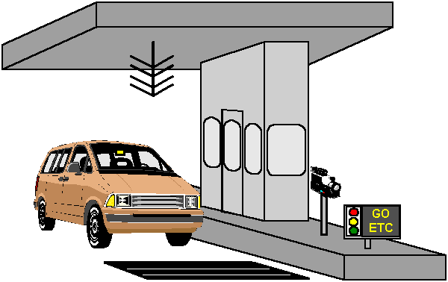
What are Enabling Products?
Design
(As-built’s)
Requirements
Production
Equipment
Test
Procedures
Test
Procedures,
Software, Jigs
User
Manuals
Maintenance
Manuals

Slide 81
Software Configuration Identification
Software configuration identification identifies items to be controlled, establishes identification schemes for the items and their versions, and establishes the tools and techniques to be used in acquiring and managing controlled items. These activities provide the basis for the other SCM activities.

Slide 82

Typical Activities of Configuration Identification
Select configuration items (CI)
Establish and maintain CI Identifiers
Identify documentation for each CI
  Location info
  Version info
  Vendor info
  Licensing/warrantee info
  etc.

Slide 83
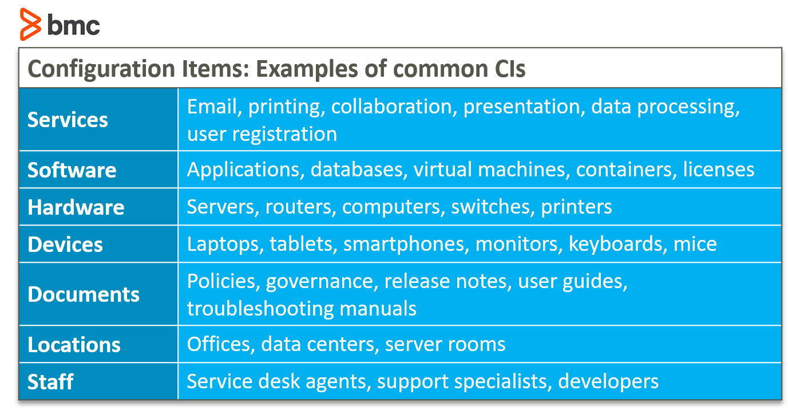
CI Example

Slide 84
organized CI records
Unique identifier
Type
Description
Relationship with other CIs
Status

Slide 85
Change Management
Configuration
Identification
Status
Accounting
CM
Planning and
Management
Change
Management
Configuration
Audits
Software configuration control is concerned with managing changes during the software life cycle. It covers the process for determining what changes to make, the authority for approving certain changes, support for the implementation of those changes, and the concept of formal deviations from project requirements as well as waivers of them. Information derived from these activities is useful in measuring change traffic and breakage as well as aspects of rework.

Slide 86
Change Management Process Model
Current Baseline
New Current Baseline
Need for
Change
Change
Identification
Approved
Change
Evaluation &
Coordination
Documented
Change
Request
Implementation
& Verification
Adapted from EIA 649

Slide 87

Change Decisions Require a Baseline
Change management begins with a stable point in system development
A baseline is a well-defined, well- documented reference point for change management
Changed system products must be placed under CM
Next baseline incorporates the changed products

Slide 88
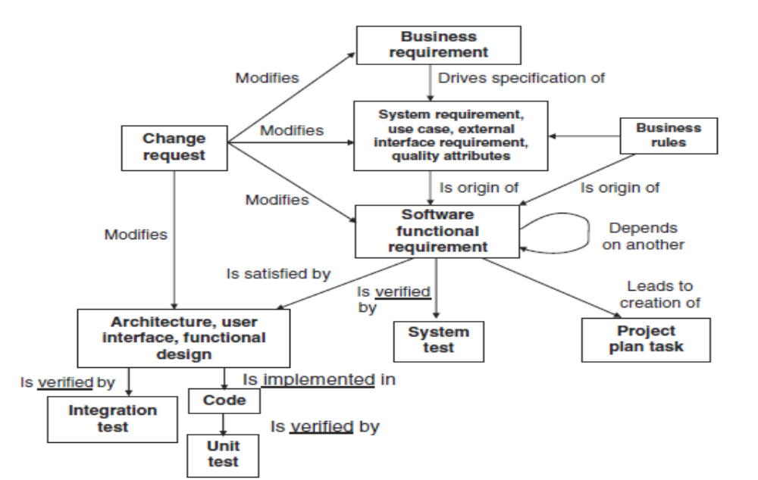
change request on a software

Slide 89
Changes to the software can have several origins:
– problem reports (PR), or trouble report (TR), from the development team,
maintenance team, or customer;
– modification/evolution requests (MR) communicated as a result of an environment
change or the need for new features;
– requests from maintenance and infrastructure (preventive and perfective)
issued to improve the maintainability of the software.

Slide 90
Requests, Evaluation, and Approval of Changes
The customer (internal or external) or a team member submits a request;
– a maintainer evaluates the priority, impact and cost;
– the Change Control Committee (CCC) or Configuration Control Board (CCB)
reviews and approves the change;
– the change is made to the software and associated documentation;
– the change is tested and approved by the end-user;
– the change is moved to production or installed in a system and verified afterward;
– the change request or ticket is closed and then later archived.

Slide 91
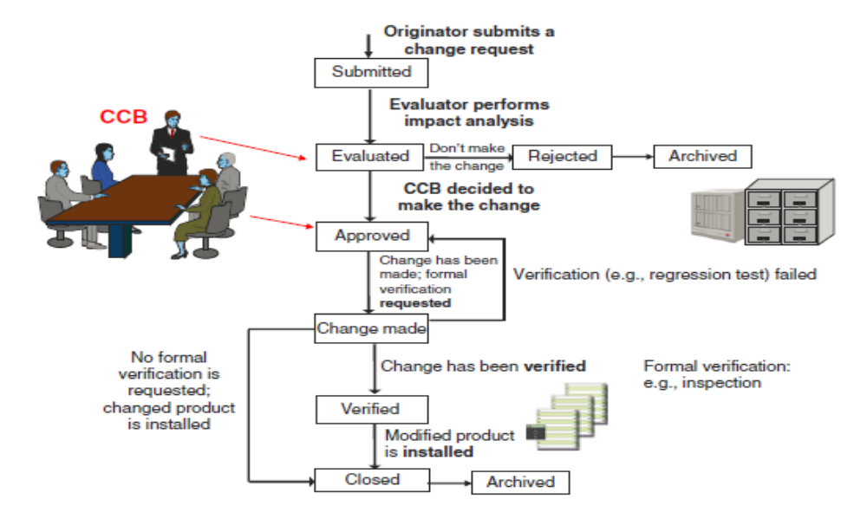
Change request change management workflow.
Source: Adapted from Wiegers (2013)

Slide 92
Change Management Policy
– the original text describing a change request will not change or will not bedeleted from the organizational repository;
– each changed requirement will be traceable to an approved change request;
all changes to requirements should followthe SCM process. If a change requestis not documented, it will not be considered;
– a CCB is created for each project;
– the contents of the change request library must be available to all project teammembers;
– no design or development/maintenance work can be initiated on unapprovedchanges, with the exception of exploration or feasibility studies required by the CCB.

Slide 93
Status Accounting in CM
Configuration
Identification
Status
Accounting
CM
Planning and
Management
Change
Management
Configuration
Audits
Software configuration status accounting (SCSA) is an element of configuration management consisting of the recording and reporting of information needed to manage a configuration effectively.

Slide 94
3 – Configuration Status Accounting
I
GSFC
Maintain records of the CIs throughout the project’s life cycle
Record and monitor all changes to CIs
Document the contents of versions, builds, and baselines
Generate periodic status reports – your CM tool may provide the reporting for you!
Software Configuration Management, March 2008

Slide 95

Status Accounting Activities
Record the currently approved configuration documentation
Record proposed changes and status
Record results of proposed changes
Provide access to reports
Safeguard the records through-out the life cycle
Ω

Slide 96
Information Concerning the Status of CI
– what is the status of item X?
– was change request X approved or rejected by the CCB?
– what has changed in this new version of this item?
– how many defects were detected last month and how many are corrected?
– what is the cause of this change request?

Slide 97
Configuration Item Status Reporting
the meeting minutes of the change management board;
– the summary and status of change requests;
– the summary and status of problem reports (including corrective measures);
– the summary of changes to software repositories;
– the revision history of CI;
– the state of software repositories;
– the results of audits of the software repositories.

Slide 98
Role of Audits in CM
Configuration
Identification
Status
Accounting
CM
Planning and
Management
Change
Management
Configuration
Audits
Application Environment

Slide 99
4 – Configuration Audits
I
GSFC
Conduct audits to maintain the integrity of the configuration baselines
Three types of CM Audits are required:
  Baseline Audit
  Functional Configuration Audit (FCA)
  Physical Configuration Audit (PCA)
Audits correspond to major milestones and must be planned and on your schedule
Software Configuration Management, March 2008

Slide 100

Configuration Audits
Audits are verifications carried out by the agency or by an independent third party
Audits verify that the product baseline matches the documentation
Audits validate that the information placed under CM is complete
Independent audits assure a non-biased evaluation

Slide 101
Baseline Audit
I
GSFC
Conducted at the end of each life cycle phase or at each major delivery
Conducted by the team’s CMO or designated team personnel; reviewed by the team’s Software Quality Engineer (SQE)
Baseline Audit -- verifies the content of the baseline
  Correct versions of CIs were used to build the baseline
  Correct version of documentation are included in the baseline
Software Configuration Management, March 2008

Slide 102
FCA and PCA
I
GSFC
Functional Configuration Audit (FCA) -- Verifies functionality of baseline after final testing
  Ensures that CIs achieve the performance and functional requirements
  Ensures that operational and support documents are complete and satisfactory
Physical Configuration Audit (PCA) -- Verifies content of baseline for major builds or deliveries
  Ensures that baseline items of a delivery match the documentation that defines it (e.g., Version Description Document (VDD), design documents)
Both conducted by the team’s CMO or designated team personnel; verified by the team’s SQE
Software Configuration Management, March 2008

Slide 103
Functional Configuration Audit
– an audit of test documentation and test results;
– audit reports of V&V to ensure their accuracy;
– a review of all approved changes to ensure they have been properly incorporated
and verified;
– a review of updated documents to ensure their accuracy;
– a sampling of minutes of design meetings to ensure that all findings have been
incorporated;
– a sampling of performance and other non-functional test results for completeness.
FCA of the outputs of the design process verifies the following
– traceability between the design items and their sources (requirements);
– every requirement is linked to at least one design element;
– every design element is linked to at least one requirement that justifies it

Slide 104
Physical Configuration Audi
A PCA will typically include the following elements
an audit of specifications to ensure completeness;
– a review of the problem reporting and change management process;
– a comparison between the architectural design and components to ensure consistency;
– a code review to assess compliance to coding standards;
– audit documentation to ensure the completeness and compliance with the format
and with functional descriptions. These manuals include user manuals,
programmer’s manual, and operator’s manuals

Slide 105
Audits Performed During a Project
– to verify that the interfaces between hardware and software comply with the
design;
– to verify that the code is fully tested and that business requirements are met;
– to check whether the product design throughout the development meets the
functional requirements;
– to check whether the code adheres to the detailed design.

Slide 106
CM Records
I
GSFC
CM Plan (including responsibilities, approach, baselines, and CI naming conventions)
Schedule of CM activities
Evidence of Change Request (CR) handling, assignment, and tracking – following the full thread thru the CM process
CCB agendas and meeting minutes
VDDs and/or Delivery Letters
CM audit results
Emails communicating audit results, configuration problems, distribution of the Plan, CRs emailed for analysis, summary of open CRs…
Software Configuration Management, March 2008

Slide 107
Different phases of the SCM implementation
SCM system design
SCM plan preparation
Scm team organization
SCM infrastructure setup
SCM team training
Project team training
SCM system implementation
SCM system operation and maintenance(configuration identification,control…)
Record retention
SCM system retirement

Slide 108
implementation issues in SCM.
Scm implementation plan
Risk assessment
Implementation strategy
Budget
Cost
Performance measurement
SCM implementation team
Problem resolution
Scm tool vendors and vendor management
Training
Employees and employee resistance
Pilot project
Company-wide implementation
Scm implmentation : The hidden costs

Slide 109
Why do many SCM implementations fail?
Lack of top management buy-in, commitment, and support
Improper planning and budgeting
User of the wrong SCM tool
Lack of training
Work culture of the organization

Slide 110
Benefit of SCM
Improved organizational competitiveness
Better customer service and improved customer goodwill
Better return on investment
Improved management control over software development activities
Improved software development productivity
Easier handling of software complexity
Improved security
Higher software reuse
Lower software maintenance cost

Slide 111
Benefit of SCM
Better quality assurance
Reduction of defects and bugs
Faster problem identification and bug fixes
Process-dependent development rather than person-dependent development
Assurance that the correct system was built.

Slide 112
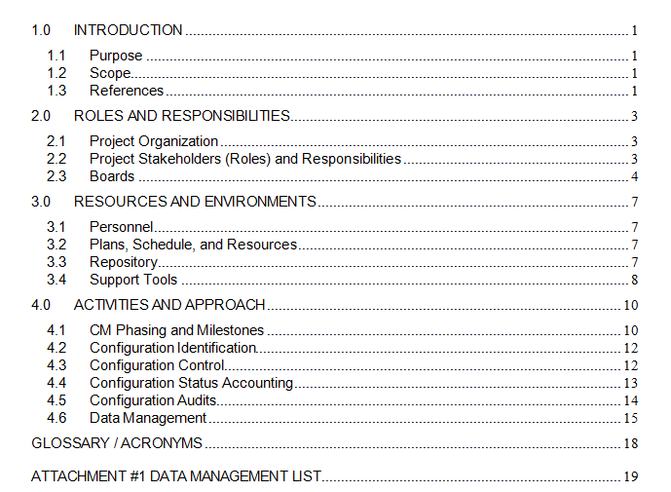
Configuration Management Plan

Slide 113
SCM AND THE SQAP
Evaluation of their adherence to the SQAP as well as the tracking of the status ofthe CIs:
– has an appropriate and effective SCM strategy, including change control processes,been implemented?
– have items generated by the process or project been identified, defined, andbaselined?
– are the requirements allocated to the system elements and their interfaces traceable to the customer’s requirements baseline?
– have modifications and releases of the items been controlled?
– has documentation been maintained in accordance with defined criteria?
– have modifications and releases been made available to affected parties?
– has the status of the items and modifications been recorded and reported?
– has the completeness and consistency of CI been ensured?
– has the storage, handling, and delivery of CI been controlled?

Slide 114
SCM AND THE SQAP
Concerning the tracking of change requests and problem reports, the followingquestions should be addressed:
– has an appropriate and effective problem management strategy been developed?
– are problems recorded, identified, and classified?
– are problems analyzed and assessed to identify an acceptable solution(s)?
– are problem resolutions implemented?
– are problems tracked to closure?
– is the status of all problems reported and known?

